Slide 1


LESSON 7 YAYY!!
MM/DD/YYYY
You can add your name here.
Let’s dive into it!!!!!

Slide 2
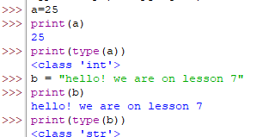

How to check Type?
Type Checking
Title of your presentation.
The question is if you are confuse about type of data then how you can check and know the type.
It’s simple, use type(variable name). As examples are given
Homework: Similarly, find types of other datatypes we did in lesson 5 & 6

Slide 3

DID YOU KNOW?
Data Conversions
Title of your presentation.
float(marks)
Here
float is the datatype we want to convert into
marks is the variable we want to convert datatype of
Did you know that you can convert the type of data after saving the type value in the variable?
DataType conversion is the process of converting data from one type to another is called as datatype conversion
We can do this using datatype_we_want_to_convert_into(Varible_we_Want_to_convert_into)

Slide 4
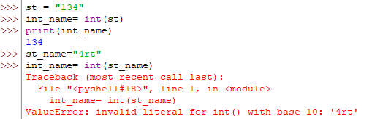



Data Conversions
Title of your presentation.
String to integer
String to List
Tuple to set
String to float
Convert all
Integer to string
Float to string
List to string
Tuple to string
Convert all
Set to list
Set to tuple
Float to integer
Few more examples

Slide 5
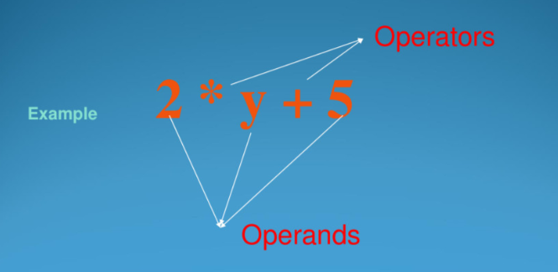
What is Expression?
Opeartors
Title of your presentation.
Combination of Operators and Operands
What is Operators?
Operators are the symbol that tells the computer to do certain calculations on our data

Slide 6
Arithmetic Operator
Types of Operators
Title of your presentation.
Name | Operator | Example
Addition | + | a + b
Subtraction | - | a – b
Multiplication | * | a * b
Division | / | a / b
Modulus | % | a % b

Slide 7
Assignment Operator
Types of Operators
Title of your presentation.
Assigning Values to variables
Operator | Operation | Example
= | Num = 5 | Num = 5
+= | Num+=5 | Num = Num + 5
-= | Num-=5 | Num = Num - 5
*= | Num*=5 | Num = Num * 5
/= | Num/=5 | Num = Num / 5
%= | Num%=5 | Num = Num % 5

Slide 8
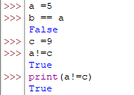
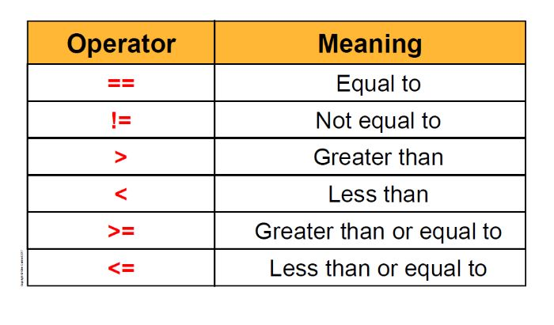
Comparison Operator
Types of Operators
Title of your presentation.
Comparing two variables

Slide 9
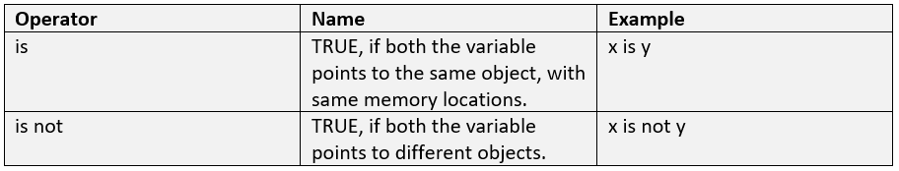
Identity Operator
Types of Operators
Title of your presentation.

Slide 10
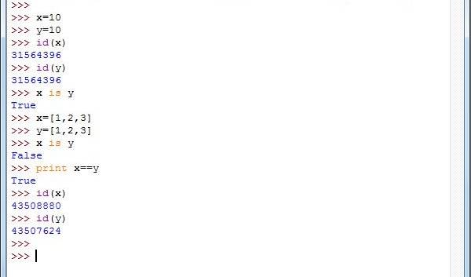
Identity Operator
Types of Operators
Title of your presentation.

Slide 11
Logical Operator
Types of Operators
Title of your presentation.
It gives Boolean Result
AND: it returns true when both the operands are true, ptherwise returns false
OR: It returns true when atleast one of the operands is true, otherwise false
NOT: If the operand is true it will return false and if the operand is false it will return true

Slide 12
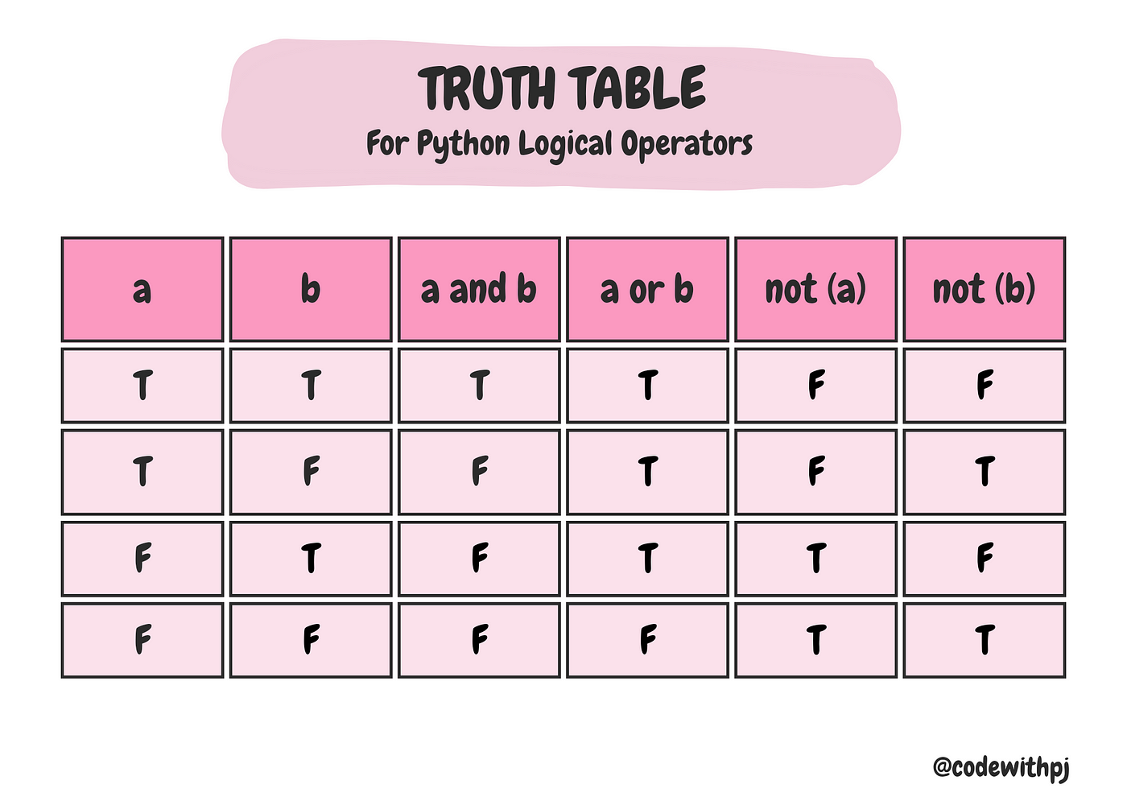
Logical Operator
Types of Operators
Title of your presentation.

